Slide 1
Pinterest Engagement Analysis
Dale Deans

Slide 2
Objective
To study the dynamics of Cooledtured's Pinterest posts and determine what variables contribute the most to how well a pin does.
Purpose: Give the UX team a some guidance when it comes to what toys should be the main display on the home screen

Slide 3
Data
The use of Apify’s Pinterest scraper, and manual inputs and assignments was done to compile the data for this project.
Dataset Columns:
Created_at - day pin was created
Id - unique ID number for each pin
Board - The brand each pin belongs to
Title - title of pin
Pin_impressions - number of impressions garnered
Pin_clicks - number of clicks garnered
Pin_saves - number of saves garnered
Type - category each pin’s content belongs to (anime, series, movie, game, music, etc.)
show/movie/game - the show, movie, game, etc. the content of each pin is based on
Days_posted - number of days the pin has been posted
Clicked - binary value reflecting whether a pin has been clicked on or not (1 or 0)

Slide 4
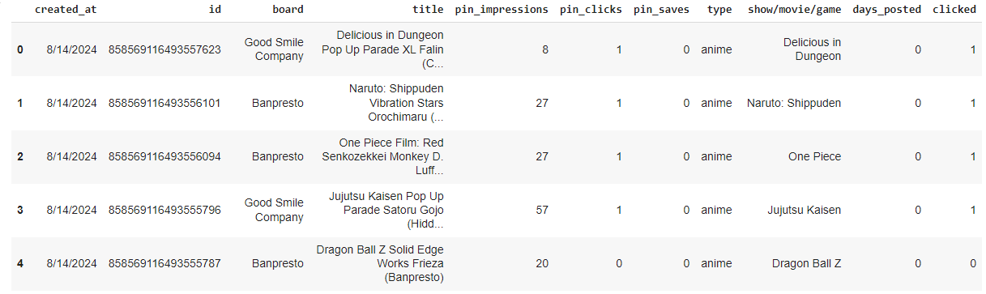
Preview of Dataset

Slide 5
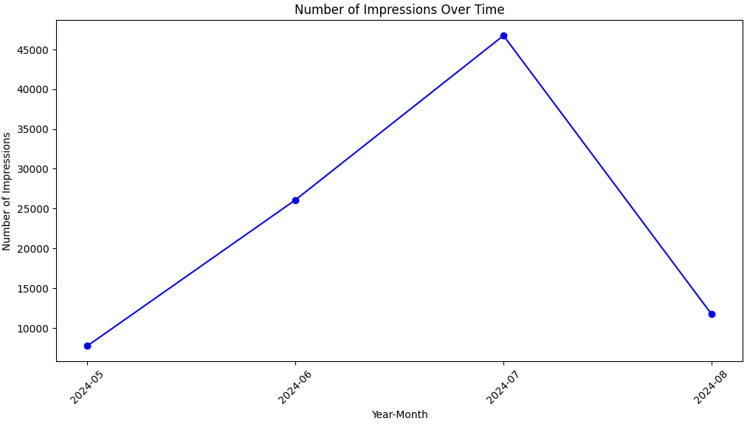
Exploratory Analysis

Slide 6
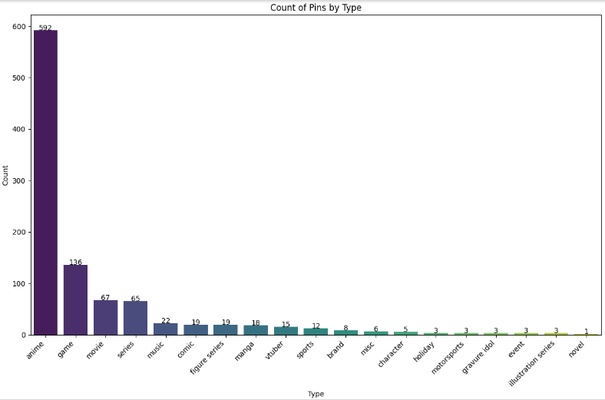
Total Pins by Type
Bar graph shows pins of toys based on animes are a vast majority of the total pins on Cooledtured’s Pinterest
Pins based on games are second followed by movies and series

Slide 7
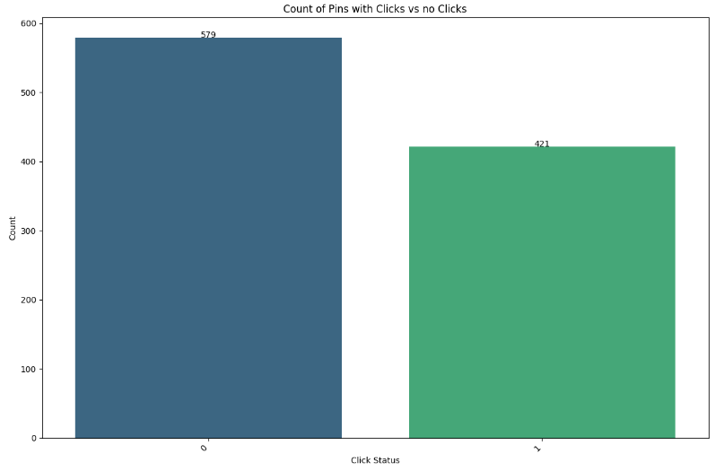
A little more than half the pins have no clicks at 579 while 421 pins have at least one click.
There isn't too much of a skew in this aspect so we shouldn't have to worry about this hindering the accuracy of the findings.

Slide 8
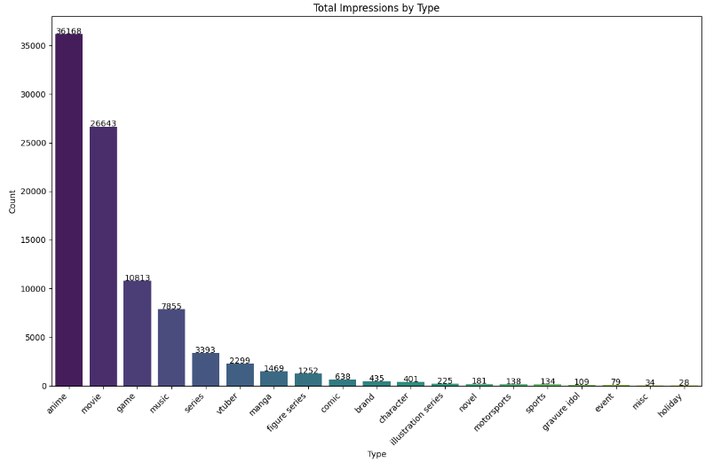
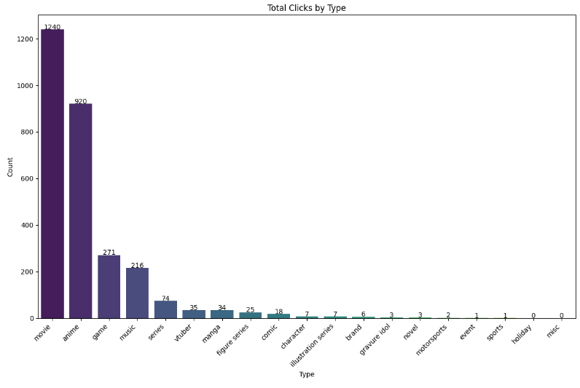
Pins based on movies have unexpectedly high totals for impressions and clicks despite only account for 67 of the 1000 pins.

Slide 9
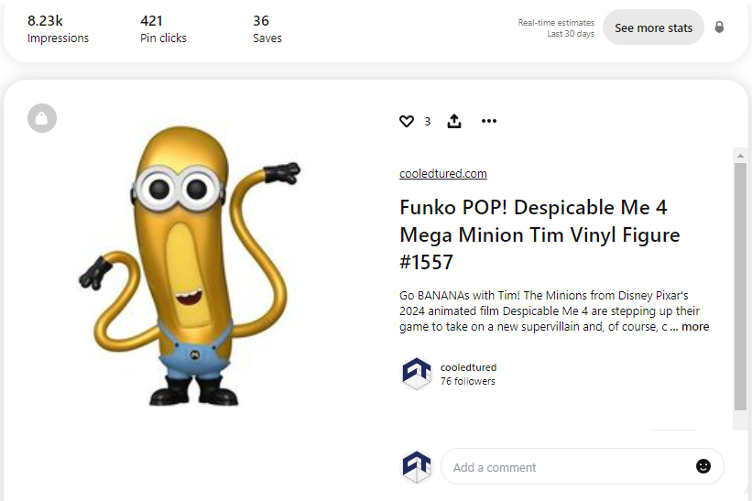
The high totals were mainly caused by how well all five pins of Funkos based on Despicable Me 4 did with 1750+ impressions and 100+ clicks.
Pins based on Deadpool & Wolverine regularly gained 100+ impressions as well.

Slide 10
Logistic Regression
A logistic regression using the column “clicked” as the target variable was done to measure the probability of a pin getting clicked on based on other variables such as “board”, “pin_impressions”, “type”, “show/movie/game”, and “days_posted”.
The resulting model was able to achieve an accuracy or 84% and an ROC AUC score of 91%.

Slide 11
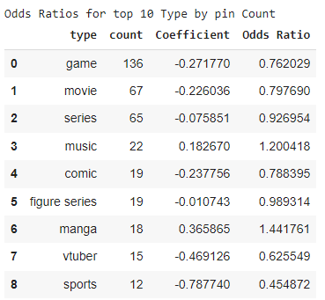
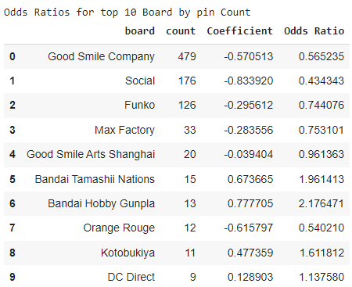
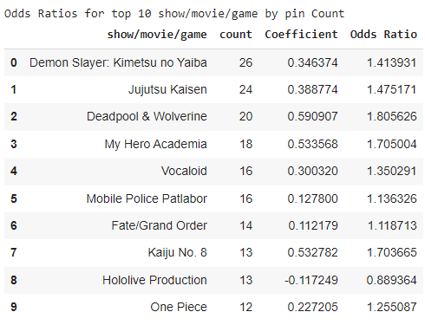
Logistic Regression Results

Slide 12
Logistic Regression Takeaways
Pins of products based on games are about 23.80% less likely to get clicked on compared the baseline which in this case is anime. Pins of products based on movies about 20.23% less likely to get clicked despite the findings in the impressions and clicks totals bar graphs.
Another interesting find is pins belonging to the Good Smile Company board is 43.48% less likely to get clicked even though Good Smile accounts for a little less than half of the pins at 479.
Deadpool & Wolverine and My Hero Academia have the highest likelihoods out of the top 10 pins counts for show/movie/game column with 80.56% and 70.5% respectively with Kaiju No.8 being a very close third at 70.37%.

Slide 13
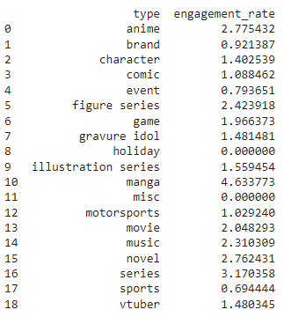
Engagement Rate by Type
The average engagement rates for the most part concur with the findings of the logistic regression.
For example, game type pins have a lower engagement rate than anime while movie type pins have a higher engagement rate than games but also a lower rate than anime, matching the order in the logistic regression.
However, there is a little skewing due to the inconsistent distribution of types, especially in the types that has very little pins to account for.

Slide 14
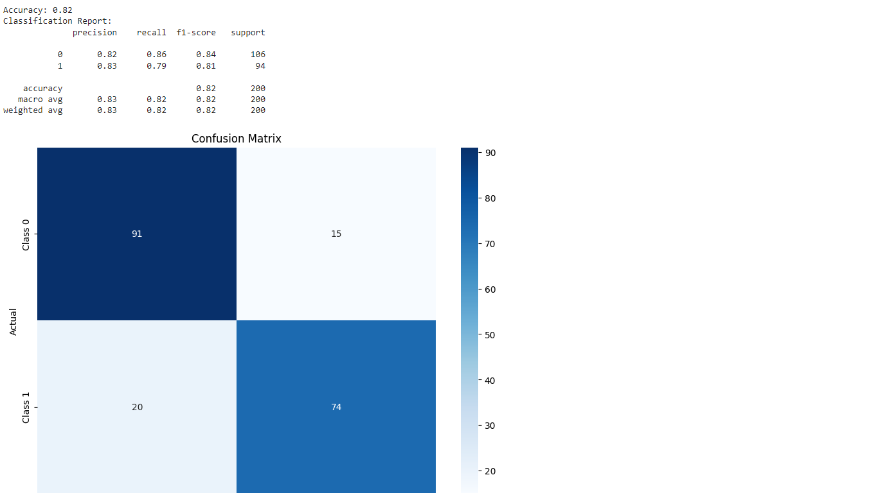
Random Forest Classification
A random forest model was trained and used to compare its results to that of the logistic regression, in hopes of getting concurring findings to solidify some of the takeaways. The model achieved an accuracy of 82% with decent precisions:

Slide 15
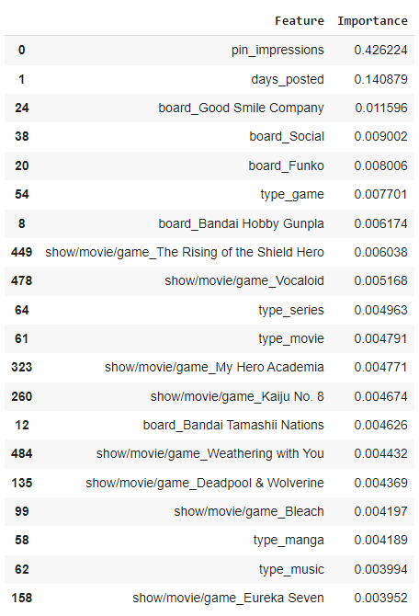
Top 20 Random Forest Feature Importances
Comparing these results to that of the logistic regression, they agree that pins belonging to game and movie types are less impactful in determining whether a pin is clicked on or not when compared to the baseline (anime).
Also concurring with the regression, My Hero Academia and Kaiju No.8 are neck and neck in importance. However, here Deadpool does seem to have a lower impact compared to its feature coefficient from the logistic regression.

Slide 16
Conclusion
Looking at the results we can determine:
Pins based on anime have higher likelihoods of getting clicked on compared to pins based on games and movies.
Pins based on the My Hero Academia and Kaiju No.8 possess a couple of the highest likelihoods of getting clicked on when compared to the other top 10 shows/movies/games in pin counts.
The board the pins belong to doesn’t seem to play that big of a factor on a pin gets clicked on since a majority of the top 10 boards in pin count have a odds ratio below 1.

